Slide 1
World Bank Data Analysis
Charley Ferrari, David Stern, Christina Taylor
Business Analytics and Data Mining
Spring 2016

Slide 2
AGENDA
Dataset and Research Question
Objective
Overview of Methodology
Achievements and Next Steps

Slide 3
Data
World Development Indicators for 214 economies,1960-2015.
20 categories, include:
Agriculture and Rural Development, Aid Effectiveness, Climate Change, Economy and Growth, Education, Energy and Mining, Environment, External Debt, Financial Sector, Gender, Health, Infrastructure, Labor and Social Protection, Poverty, Private Sector, Public Sector, Science and Technology, Social Development, Trade, Urban Development.
Data is presented on a global, regional, and national level. We are performing analysis at the national level.

Slide 4
How could we predict development?
Health: TB Incidence
Education: Pre-Primary Enrollment
Technology: Internet Usage
Notes:
Challenges:
Number of variables, collinearity, serially correlated errors, missing data
Assumptions:
A predictor variable’s impact on an indicator is similar among income groups

Slide 5
Panel Regression
Multiple subjects (countries) observed over a time series
The cross-sectional information reflected the differences between subjects. The time-series (or within-subject information) reflected in the changes within subjects over time.
Panel regression takes advantage of these different types of information.
While it is possible to use ordinary multiple regression techniques on panel data, the estimates of coefficients may be subject to omitted variable bias
With panel regression, it is possible to control for some omitted variables even without observing them. By observing changes in the predictors over time, we can control for omitted variables that differ between cases, but are constant over time. We may also use panel data to control for omitted variables that vary over time, but are constant between subjects.

Slide 6
PANEL DATA STRUCTURE
Country | Year | Indicator 1 | Indicator 2 | Indicator 3
Albania | 1960 | 46.23 | 12 | 125.0
Albania | 1961 | 48.10 | 14 | 145.6
Albania | 1962 | 50.98 | 15 | 150.9
Albania | 1963 | 61.00 | 14 | 150.8
Bangladesh | 1960 | 72.36 | 32 | 67.9
Bangladesh | 1961 | 75.19 | 34 | 68.7
Bangladesh | 1962 | 76.72 | 35 | 60.2
Bangladesh | 1963 | 76.98 | 30 | 59.3
Vietnam | 1960 | 12.38 | 41 | 103.6
Vietnam | 1961 | 12.98 | 40 | 104.7
Vietnam | 1962 | 10.05 | 39 | 109.8
Vietnam | 1963 | 8.67 | 38 | 120.3

Slide 7
Exploratory analysis of Tuberculosis Incidence
TB Incidence ~ Foreign Aid

Slide 8
Modeling by Country
As a first step, we can just simply model Tuberculosis as a function of country. We can do this by using country as a categorical variable, and creating 49 dummy variables for our data.
This method on its own is the same as an analysis of variance (ANOVA). In ANOVA, the central question is whether or not the means of different group are significantly different from each other. In a linear regression, we can look at p-values of each dummy variable to decide the significance
ICC
The ICC, or Intra-class correlation coefficient, is the ratio of the variance in y due to the fixed effects to the total variance in y.
Having an ICC this close to 1 implies what we saw in our plots earlier: The variation between groups is accounting for most of the variation of this particular dataset.

Slide 9
Analysis of Internet Usage
Internet Users ~ GDP Per Capita

Slide 10
Exploration
The grouping by country explains 85% of the variance
ICC confirms the variation between countries is accounting for most of the variation
The effect of GDP is minimal compared to country
OLS fit’s correlation coefficient is (absurdly) negative

Slide 11
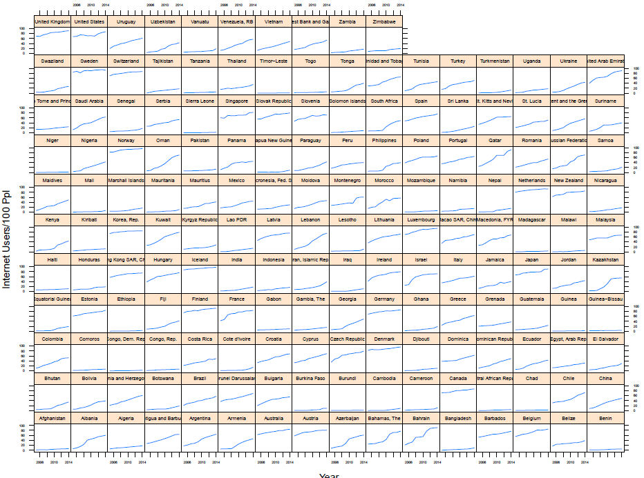
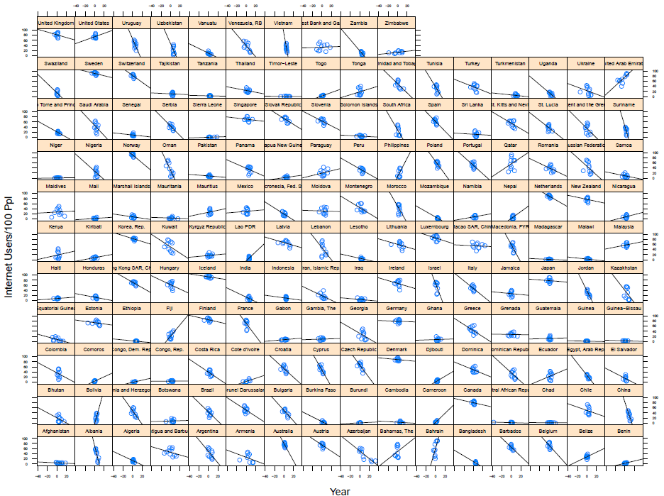
Fixed vs. Random Effects
Variation by Country
Within country variance

Slide 12
Analysis of Enrollment in primary education
Pre-Primary Enrollment ~ GDP Per Capita

Slide 13
Exploration
Considered 40+ predictors, many were eliminated due to NA’s
The grouping by country explains 96% of the variance!
ICC is also useful here in confirming the proportion of between- country variation constitutes of the entire variance.
This figure decreases by 1% when we perform the same analysis on the subset of countries that are categorized as “low income”
Pre-Primary enroll. almost entirely time-invariant attributed of a country
What explains these outcomes between states?
Possible Indicators: Foreign Aid, Per Capita GDP, Pct. Population under 14, Pupil-Teacher Ratio, Primary Education Spending, Pct. Children in Employment, Children with HIV, Pct. of Primary Teachers who are trained

Slide 14
Initial findings
Using the plm function, we performed two separate panel regressions, using Foreign Aid and GDP (per capita)
Foreign Aid was not a statistically significant predictors
GDP is significant, and negative, coefficient: -0.18
Experimenting with 40+ predictors related to education and child welfare, found that a few were statistically significant:
Pct. Population Under 14, coefficient: -3.30
Pupil-Teacher Ratio in Primary Education: -0.89

Slide 15
Next Steps
For each approach, we can use the plm package to fit models with fixed, random, and pooled effects. The Hausman test will help us choose between fixed and random effects models.
Use generalized least squares (GLS) regression for our panel models where ordinary and weighted least squares is not efficient.

